Slide 1
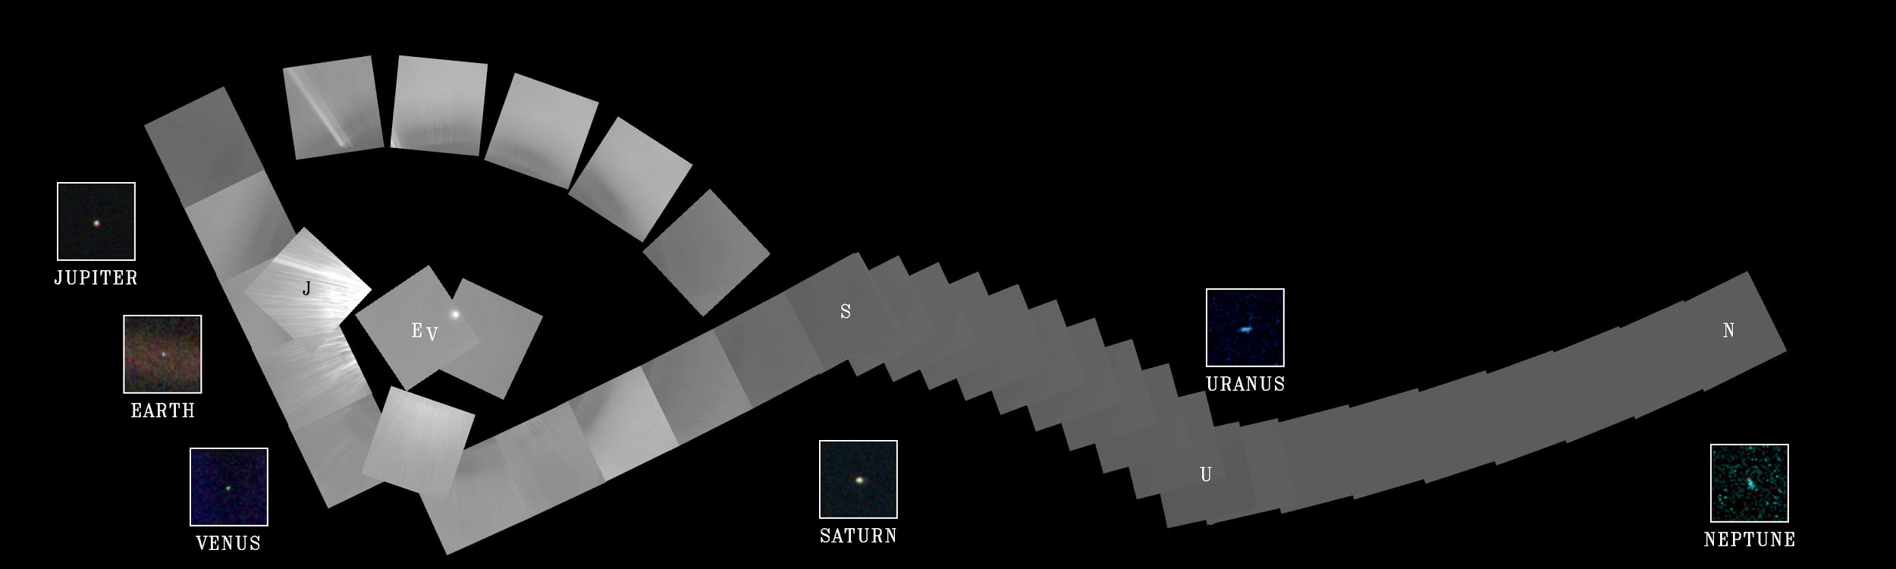
AE673A
Group Number- 3
Mataria Pence Jagatkumar (170382)
Amrendra Pratap Singh (170097)
Aditya Raghuwanshi (170052)

Slide 2
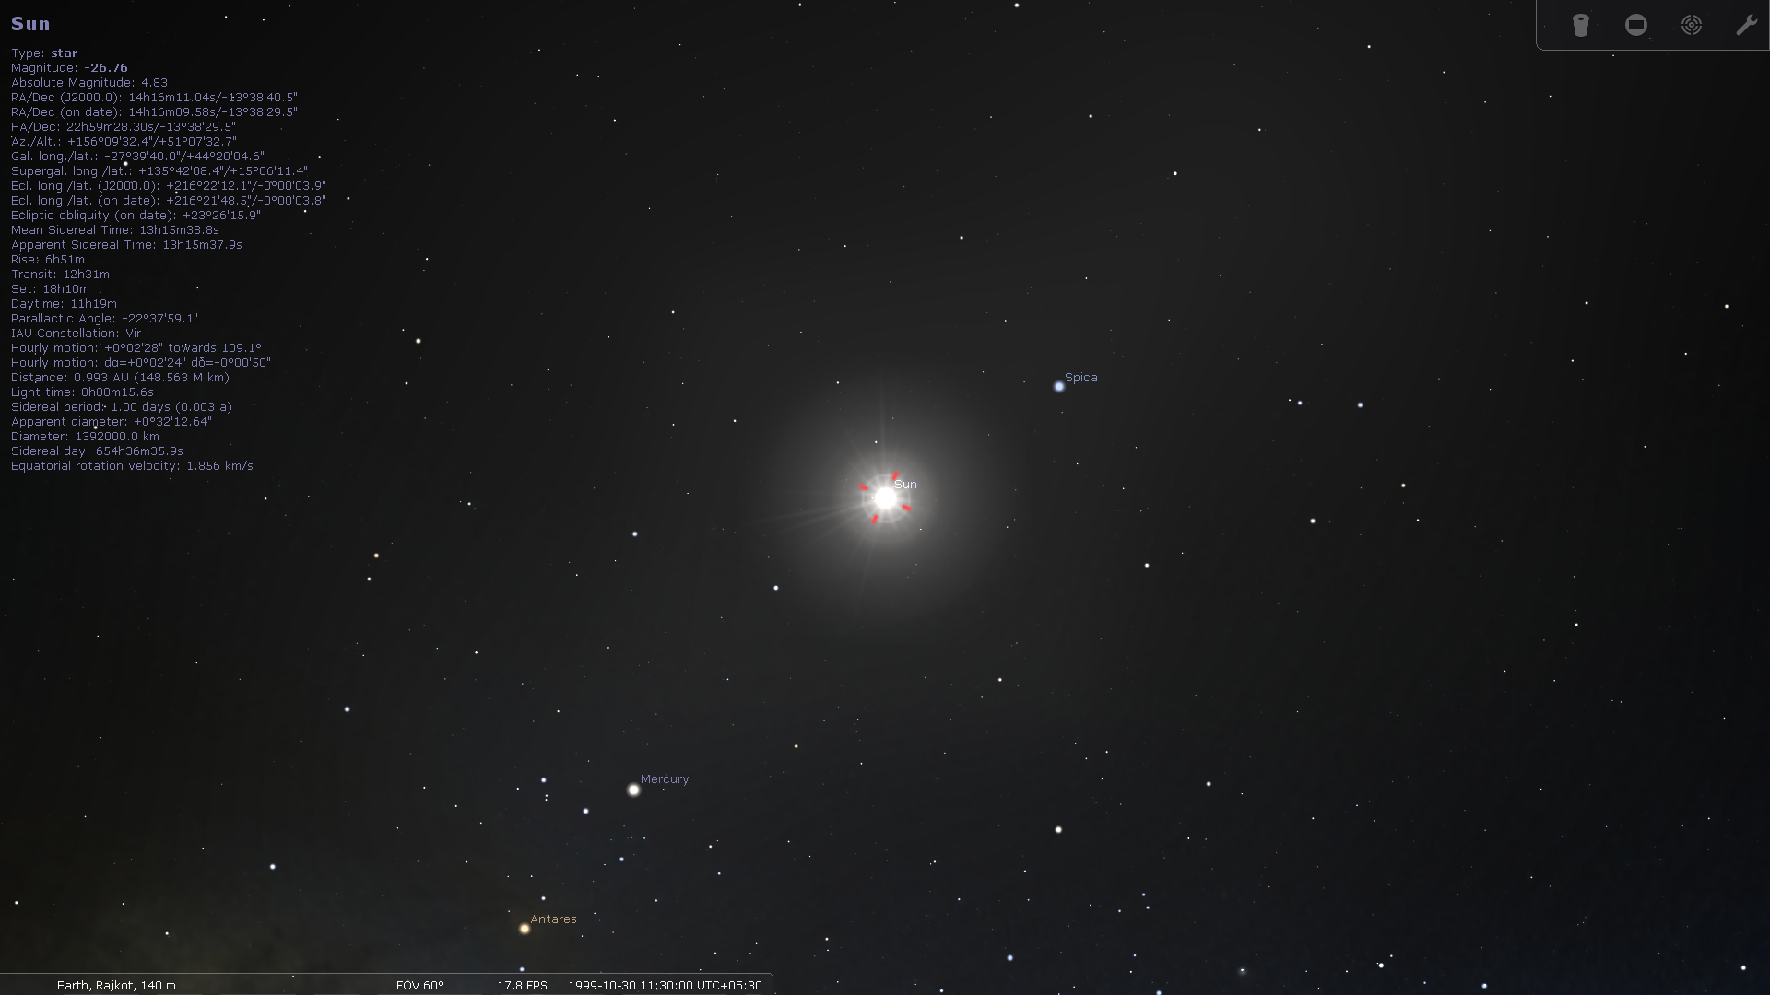
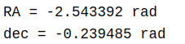
MATLAB Values
Upon Conversion of Sterillium values,
RA= -2.6226 rad
declination= -0.2381 rad
RA and Declination values from both the sources are nearly same. Hence our MATLAB code is perfectly good for this
Solar Objects | RA | Declination | Altitude | Azimuth
Sun | 14h16m09.58s | -13º38’29.5” | +51º07’32.5” | +156º09’32.4”

Slide 3
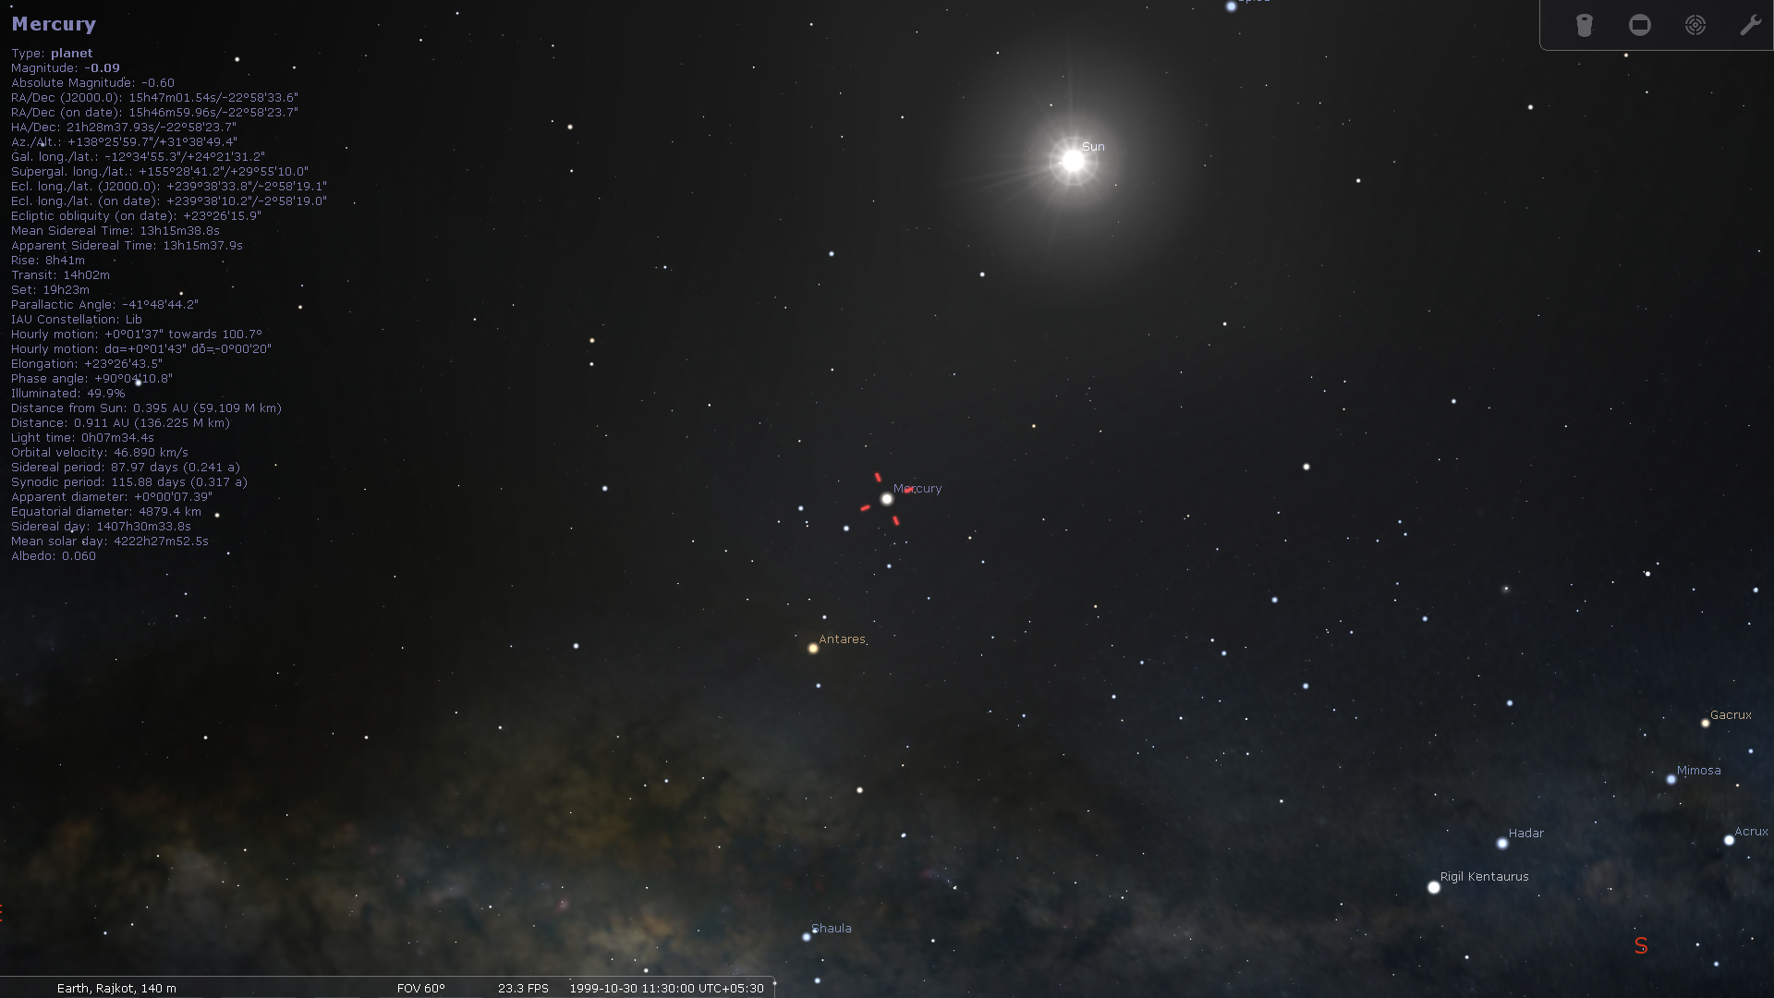
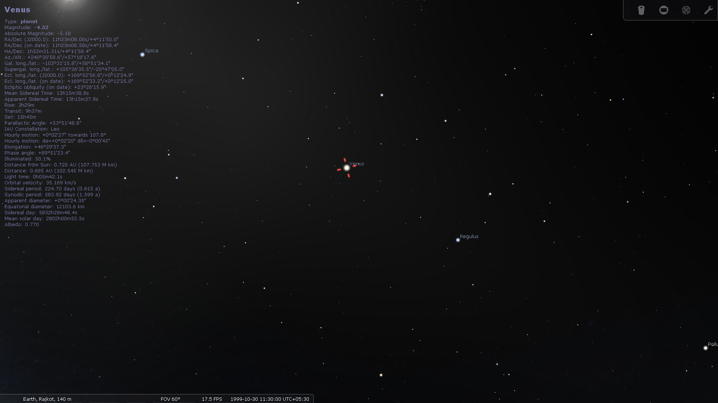
Solar Objects | RA | Declination | Altitude | Azimuth
Mercury | 15hr46m59.96s | -22º58’23.7’’ | +31º38’49.4’’ | +138º25’59.7’’
Venus | 11h23m06.58s | +4º11’58.4” | +57º18’17.6” | +240º30’58.6”

Slide 4
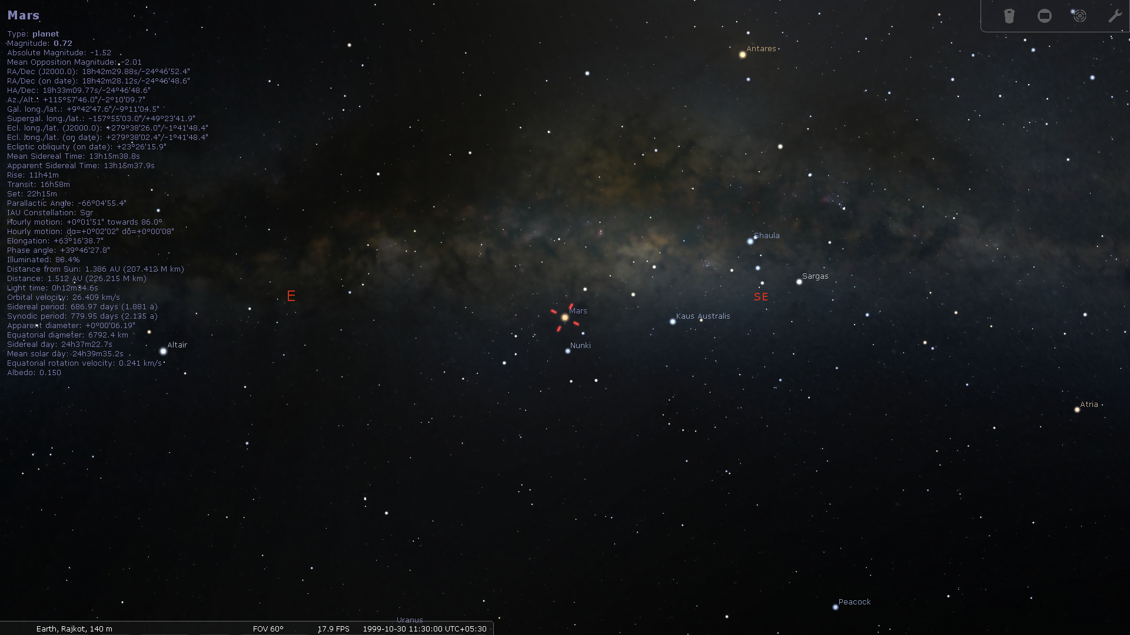
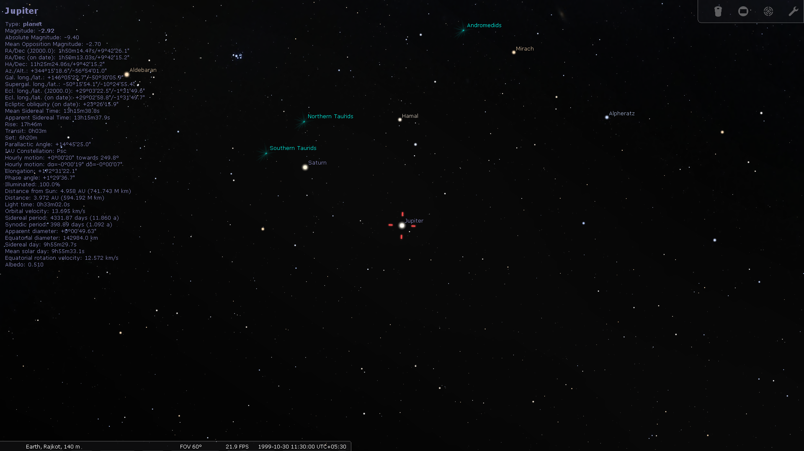
Solar Objects | RA | Declination | Altitude | Azimuth
Mars | 18h42m28.12s | -24º46’48.6’’ | -02º10’09.7’’ | +115º57’46.0’’
Jupiter | 01h50m13.03s | +09º42’15.2’’ | -56º54’01.0’’ | +344º15’18.6’’

Slide 5
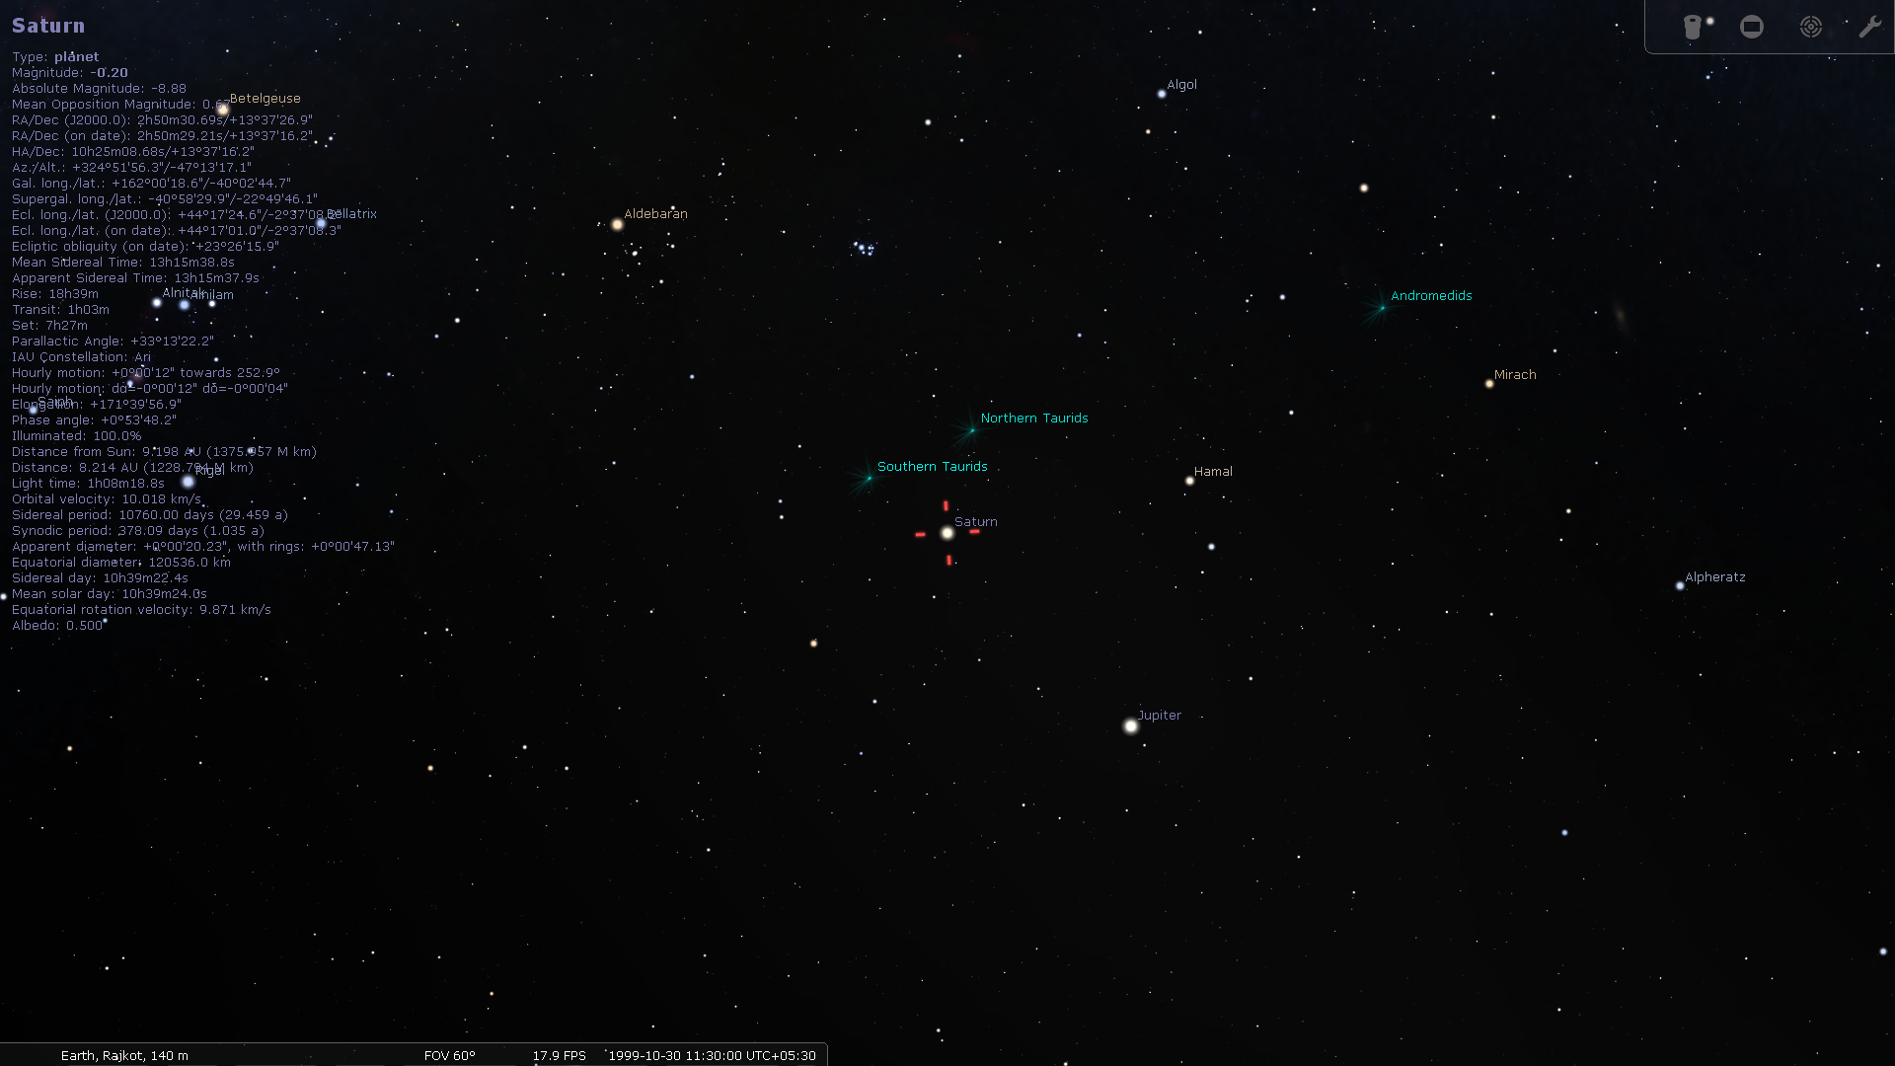
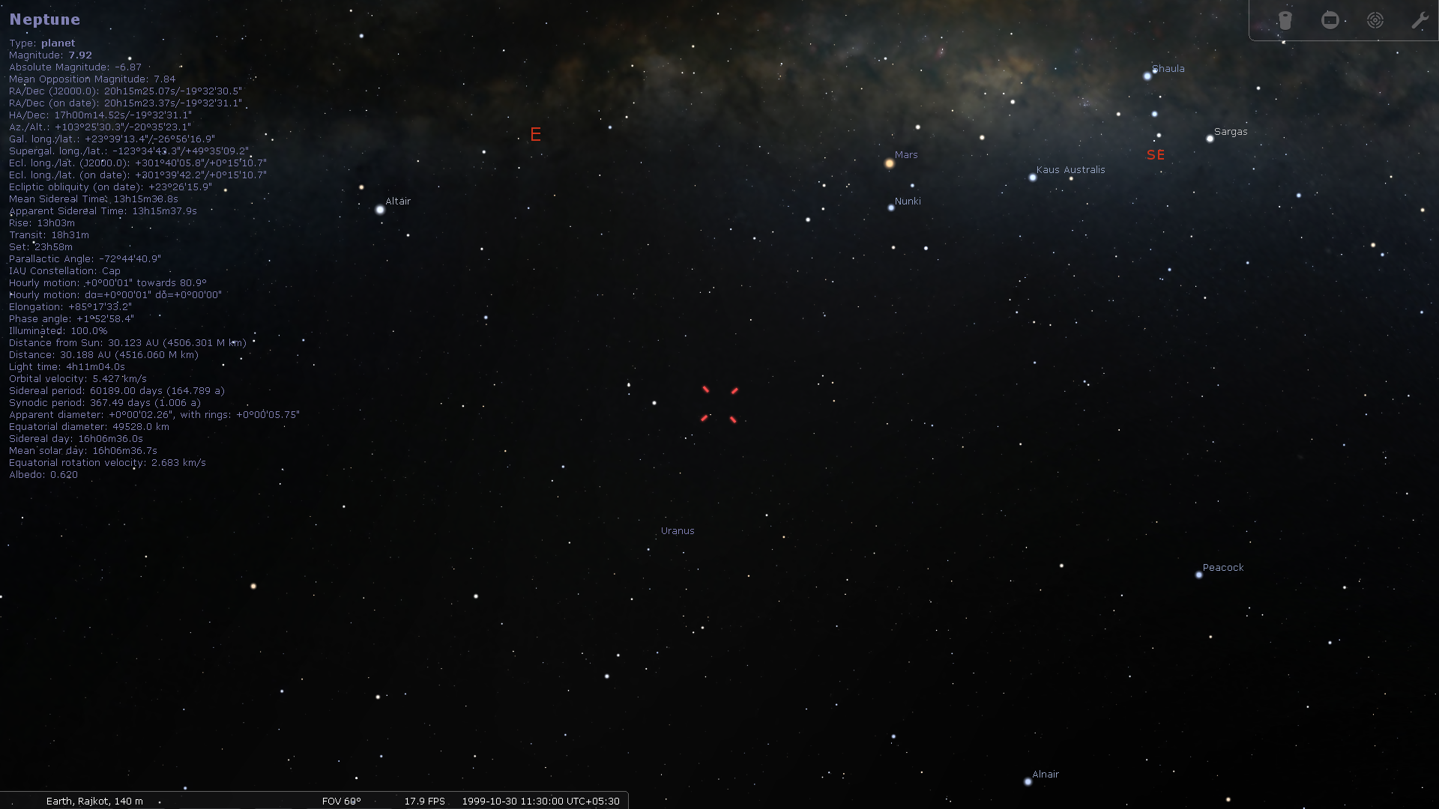
Solar Objects | RA | Declination | Altitude | Azimuth
Saturn | 2h50m29.21s | +13º37’16.2” | -47º02’44.7” | +324º51’56.3”
Neptune | 20h15m23.37s | -19º32’31.1” | -20º35’23.1” | +103º25’30.3”

Slide 6
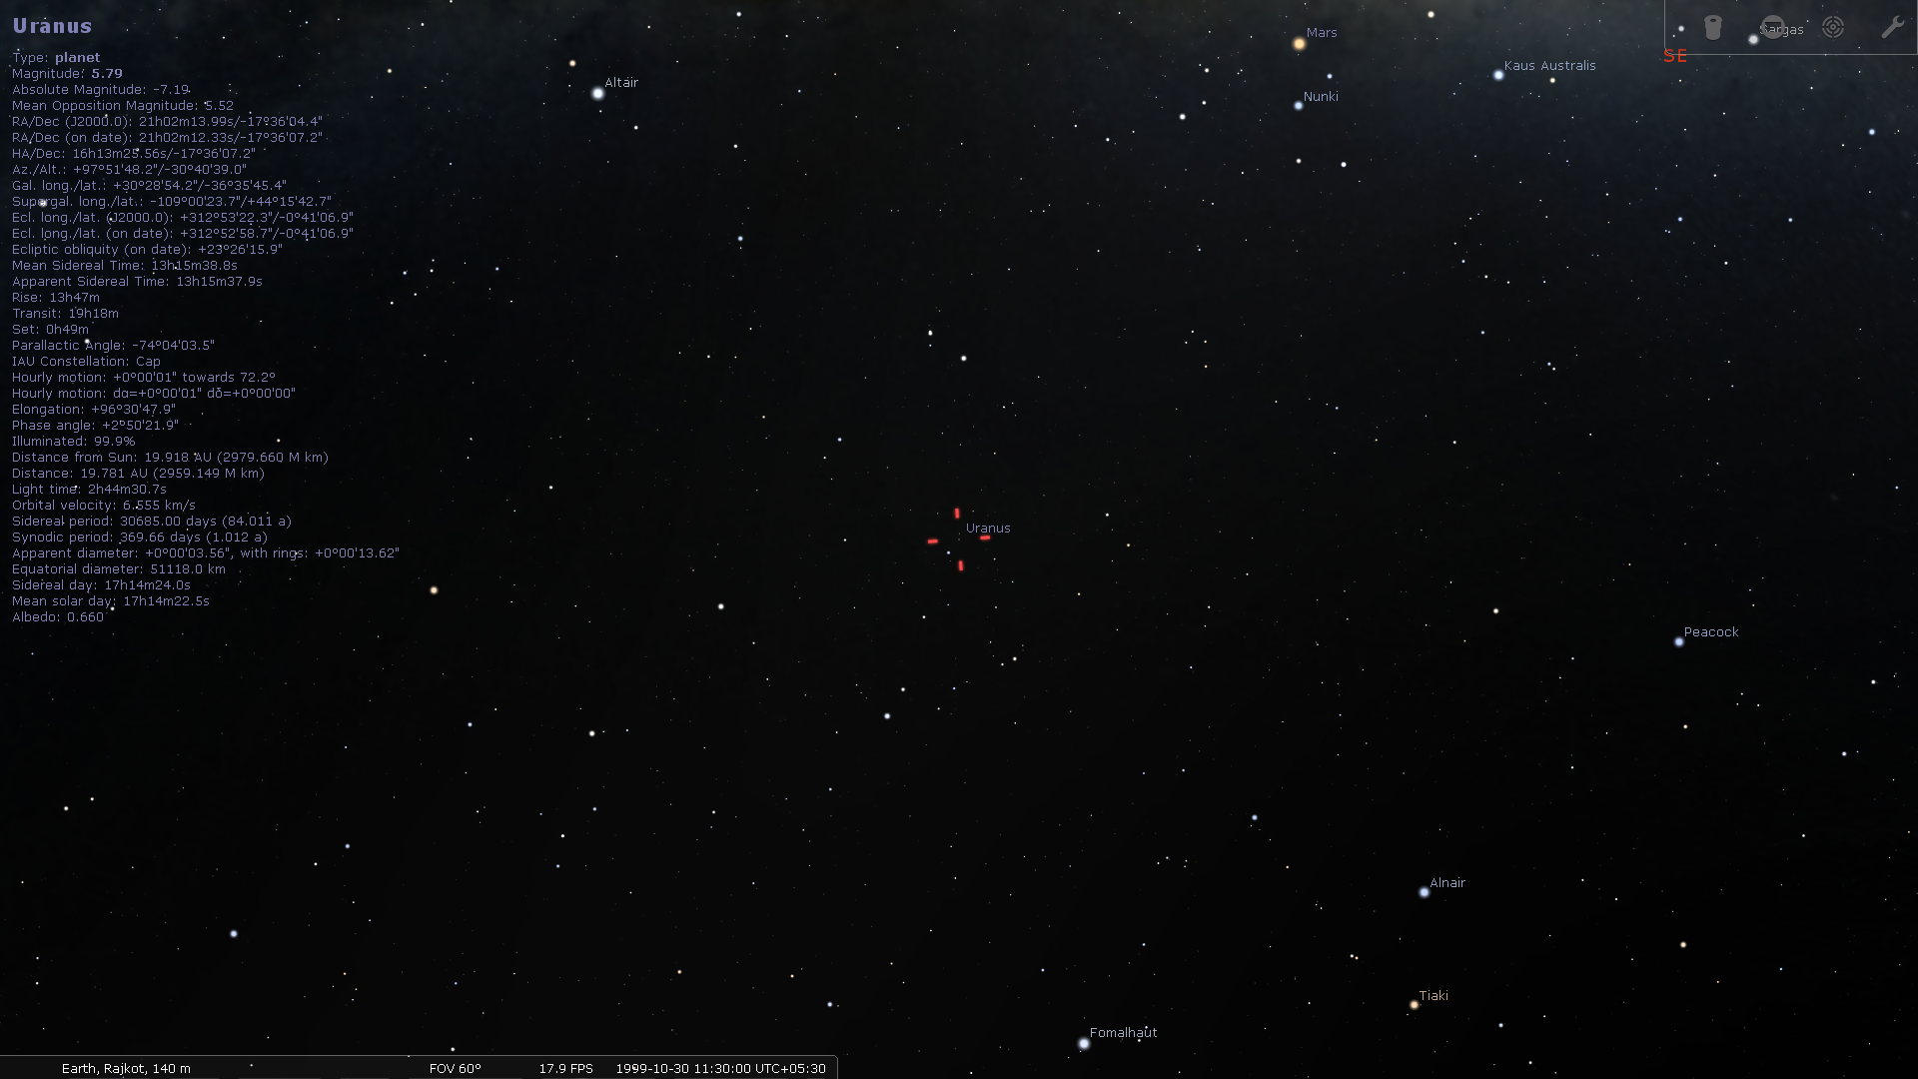
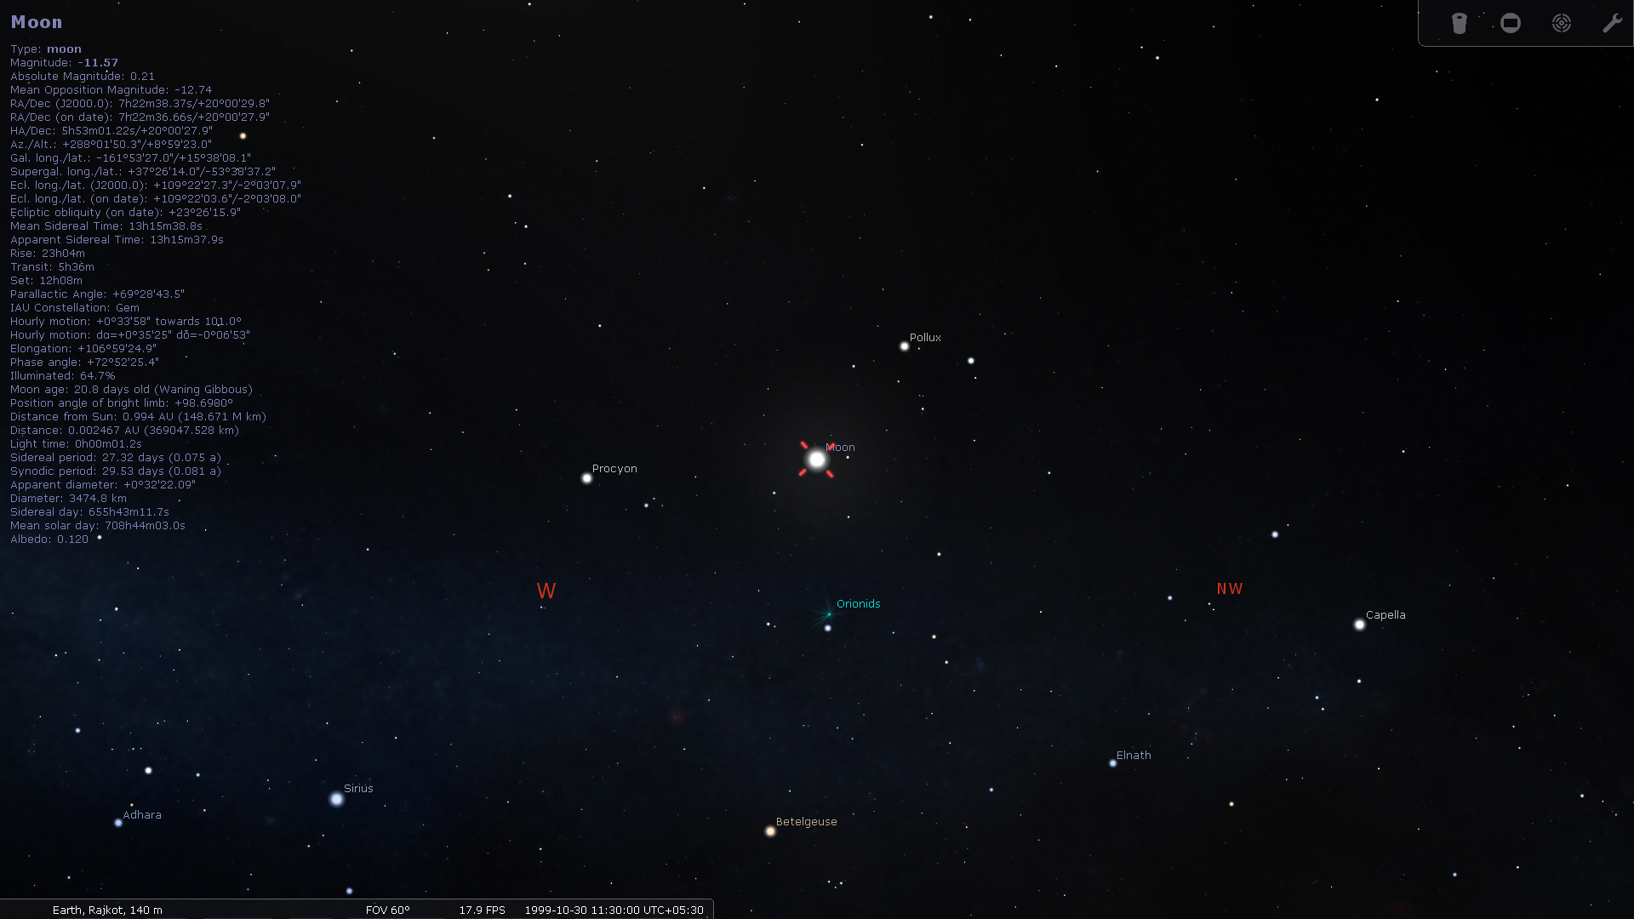
Solar Objects | RA | Declination | Altitude | Azimuth
Moon | 07h22m36.66s | +20º00’27.9’’ | +8º59’23.0 | +288º01’50.3’’
Uranus | 21h02m12.33s | -17º36’07.2” | -30º40’39.0” | +97º51’48.2”

Slide 7
[RA,delta] = SolarAzElq('1999-10-30 11:30:00',22.2913,70.7930,140);
fprintf('RA = %f rad \n',RA)
fprintf('dec = %f rad \n',delta)
function [RA,delta] = SolarAzElq(UTC,Lat,Lon,Alt)
if nargin<4 || isempty(Alt), Alt = 0; end
d2r = pi/180; %radiance to degrees conversion factor
r2d = 180/pi; %radiance to degrees conversion factor
if ischar(UTC)
UTC = cellstr(UTC);
end
if iscell(UTC)
UTC = reshape(datenum(UTC(:),'yyyy-mm-dd HH:MM:SS'),size(UTC));
end
[year,month,day,hour,min,sec] = datevec(UTC);
if ndims(UTC)>2 %#ok<ISMAT>
year = reshape(year ,size(UTC));
month = reshape(month,size(UTC));
day = reshape(day ,size(UTC));
hour = reshape(hour ,size(UTC));
min = reshape(min ,size(UTC));
sec = reshape(sec ,size(UTC));
end
[jd,UTH] = juliandate(year,month,day,hour,min,sec);
day = jd - 2451543.5;
w = 282.9404 + 4.70935e-5 * day;
e = 0.016709 - 1.151e-9 * day;
M = mod(356.0470 + 0.9856002585 * day, 360);
L = w + M;
oblecl = (23.4393 - 3.563e-7 * day)*d2r;
E = M + r2d*e.*sin(M*d2r).*(1+e.*cos(M*d2r));
x = cos(E*d2r)-e;
year = sin(E*d2r).*sqrt(1-e.^2);
r = sqrt(x.^2 + year.^2);
v = atan2(year,x)*r2d;
lon = v + w;
xeclip = r.*cos(lon*d2r);
yeclip = r.*sin(lon*d2r);
zeclip = 0;
xequat = xeclip;
yequat = yeclip.*cos(oblecl) + zeclip*sin(oblecl);
zequat = yeclip.*sin(0.409115648642983) + zeclip*cos(oblecl);
r = sqrt(xequat.^2 + yequat.^2 + zequat.^2) - (Alt/149598000);
RA = atan2(yequat,xequat); % in radians
delta = asin(zequat./r); % in radians
end
function [jd,UTH] = juliandate(year,month,day,hour,min,sec)

Slide 8
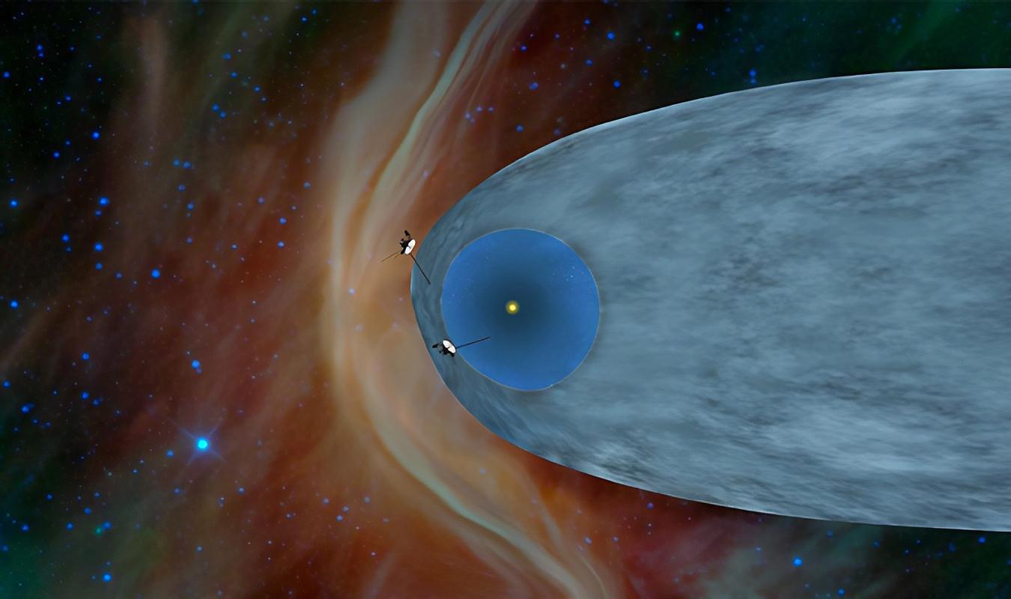
OBJECTIVE: Voyagers were designed to conduct close up studies of Jupiter and Saturn, Saturn's rings, and the larger moons of the two planets.
"Further than anyone, or anything, in history"
VOYAGER
INTERSTELLAR MISSION
Voyager Interstellar Mission

Slide 9

The Mission
OBJECTIVE: Voyagers were designed to conduct close up studies of Jupiter and Saturn, Saturn's rings, and the larger moons of the two planets.
The initial mission was launched in 1977 to study Jupiter, Uranus, Saturn, Neptune.
The mission was a part of “The Grand Tour”.
The original mission got extended to “Voyager Interstellar Mission”.
They are the only and the farthest interstellar man made probes in the history.
Expected to cross the realms of Milky way.
Voyager Interstellar Mission

Slide 10
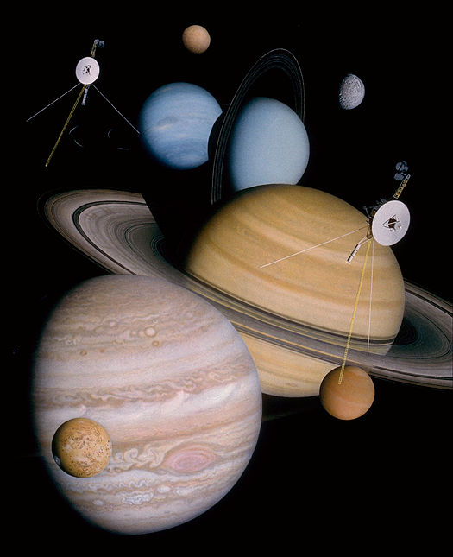
Astonishing Discoveries
OBJECTIVE: Voyagers were designed to conduct close up studies of Jupiter and Saturn, Saturn's rings, and the larger moons of the two planets.
Active Volcanoes on Jupiter’s moon Io.
V1 Discovered the Rings and moons of Jupiter.
Various data on Saturn surface and its moons.
V2 revealed the Great Red Spot on Jupiter to be a complex storm system, and also imaged several smaller storms.
All our knowledge of Uranus and Neptune comes from V2.
On Uranus, V 2 found evidence of an ocean of boiling water about 500 miles (800 kilometers) below its cloud tops.
In October 2020, Voyagers confirmed high density of space outside the solar system.
Voyager Interstellar Mission
Notes:
Voyager 2 also used it as a springboard to Saturn, using the gravity-assist technique

Slide 11
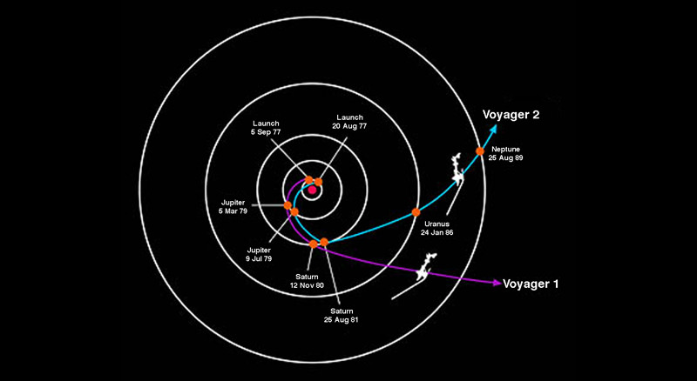
OBJECTIVE: Voyagers were designed to conduct close up studies of Jupiter and Saturn, Saturn's rings, and the larger moons of the two planets.
Timeline
Voyager Interstellar Mission

Slide 12
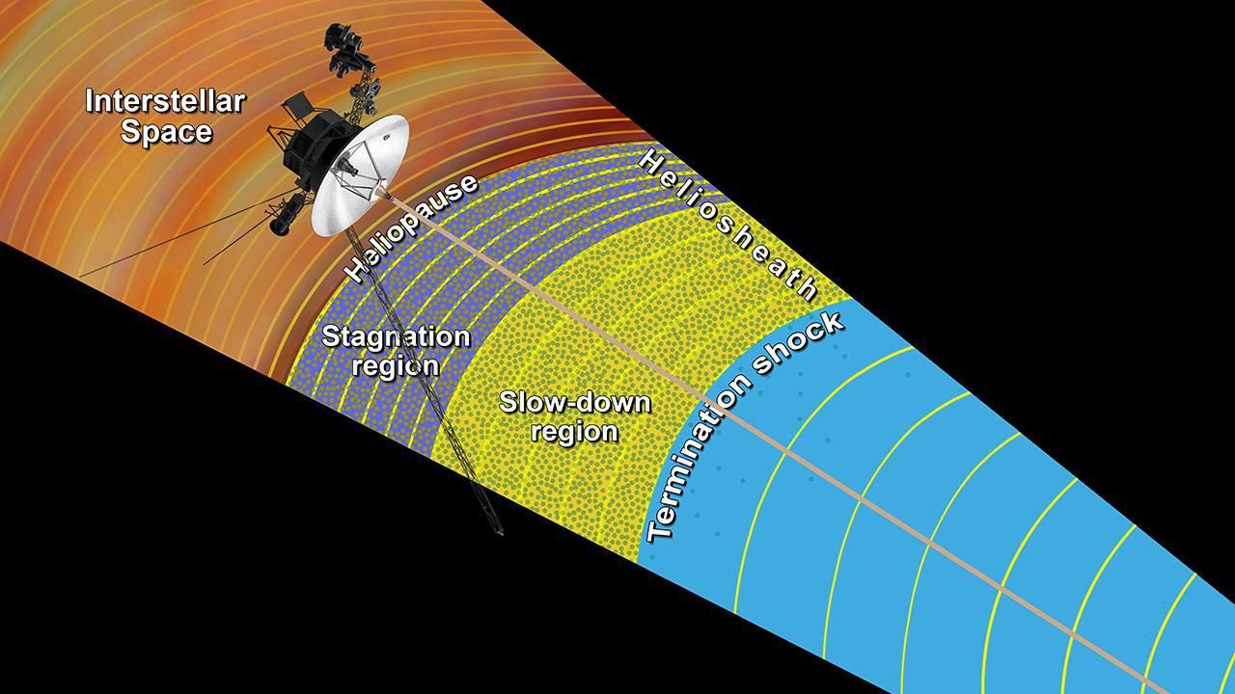
Interstellar Entry
August 1, 2012
December 10, 2018

Slide 13
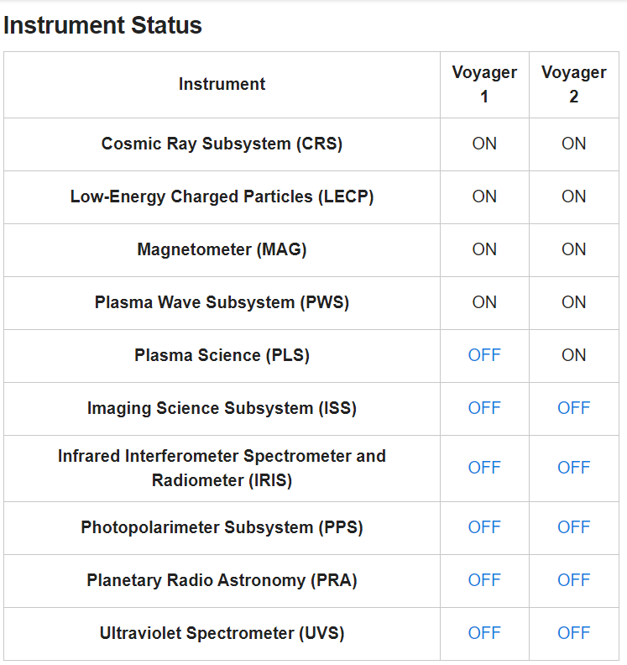
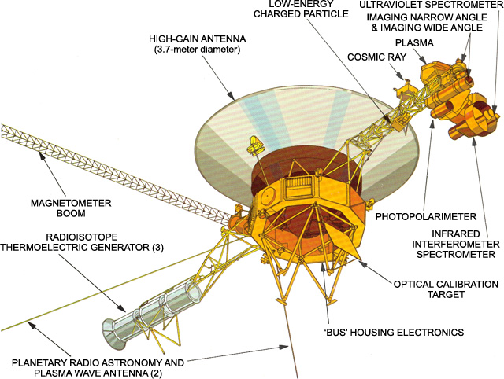
Instruments

Slide 14
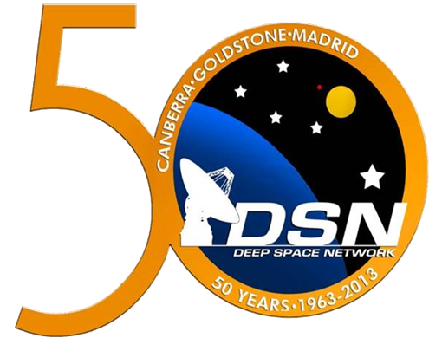
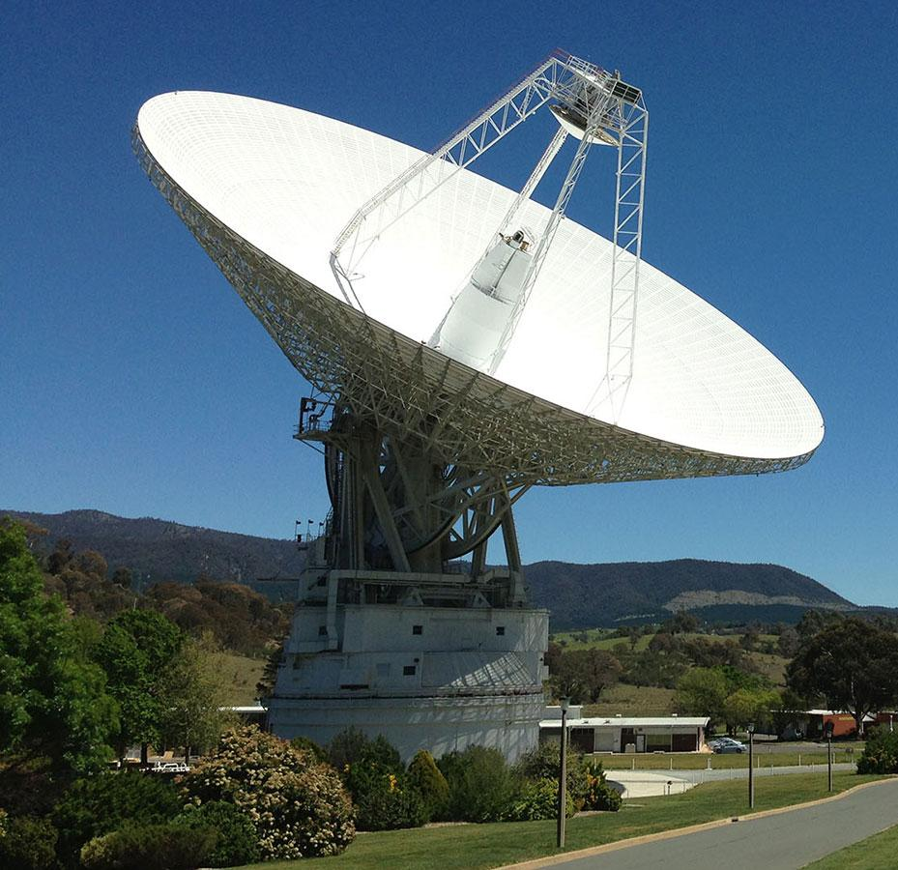
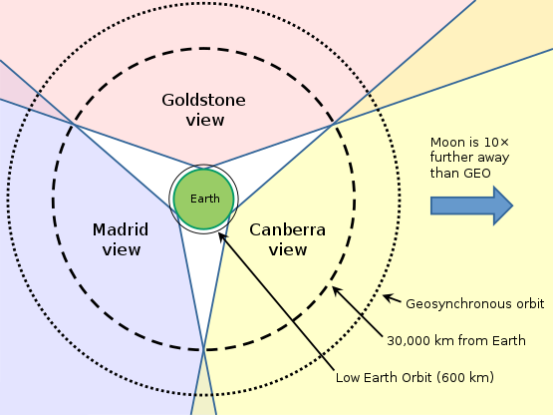
Communication
OBJECTIVE: Voyagers were designed to conduct close up studies of Jupiter and Saturn, Saturn's rings, and the larger moons of the two planets.
20KW Uplink
20W Downlink
Voyager Interstellar Mission
Notes:
Voyager 2 also used it as a springboard to Saturn, using the gravity-assist technique

Slide 15
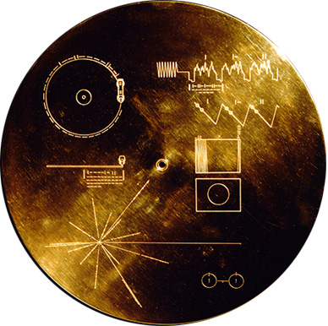
The Golden Record
OBJECTIVE: Voyagers were designed to conduct close up studies of Jupiter and Saturn, Saturn's rings, and the larger moons of the two planets.
Variety of natural sounds, such as those made by surf, wind and thunder, birds, whales, and other animals
115 images (encoded in analog form)
Music (total duration of 90min)
Spoken greetings from Earth-people (in fifty-five languages)
Voyager Interstellar Mission
Notes:
Voyager 2 also used it as a springboard to Saturn, using the gravity-assist technique

Slide 16
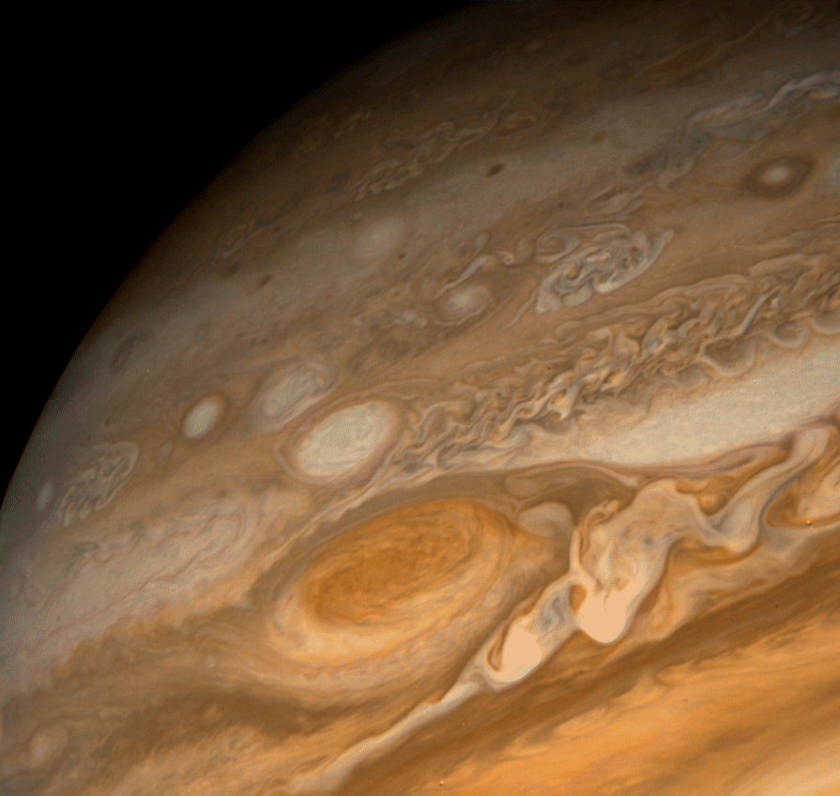
THANK YOU!
Image Resources: Google Images

